Slide 2
Review of Un-Informed Search Strategies and game playing;
Informed search Strategies: A*, Heuristic functions, Memory Bounded Search (IDA*, SMA*);
Iterative improvement Search (Hill Climbing, Simulated Annealing), constraint satisfaction problems.

Slide 3
Artificial Intelligence is the study of building agents that act rationally. Most of the time, these agents perform some kind of search algorithm in the background in order to achieve their tasks.
A search problem consists of:
A State Space. Set of all possible states where you can be.
A Start State. The state from where the search begins.
A Goal State. A function that looks at the current state returns whether or not it is the goal state.
The Solution to a search problem is a sequence of actions, called the plan that transforms the start state to the goal state.
This plan is achieved through search algorithms.

Slide 4
A state space is a way to mathematically represent a problem by defining all the possible states in which the problem can be. This is used in search algorithms to represent the initial state, goal state, and current state of the problem. Each state in the state space is represented using a set of variables.
The efficiency of the search algorithm greatly depends on the size of the state space, and it is important to choose an appropriate representation and search strategy to search the state space efficiently.
One of the most well-known state space search algorithms is the A algorithm. Other commonly used state space search algorithms include breadth-first search (BFS), depth-first search (DFS), hill climbing, simulated annealing, and genetic algorithms.

Slide 5
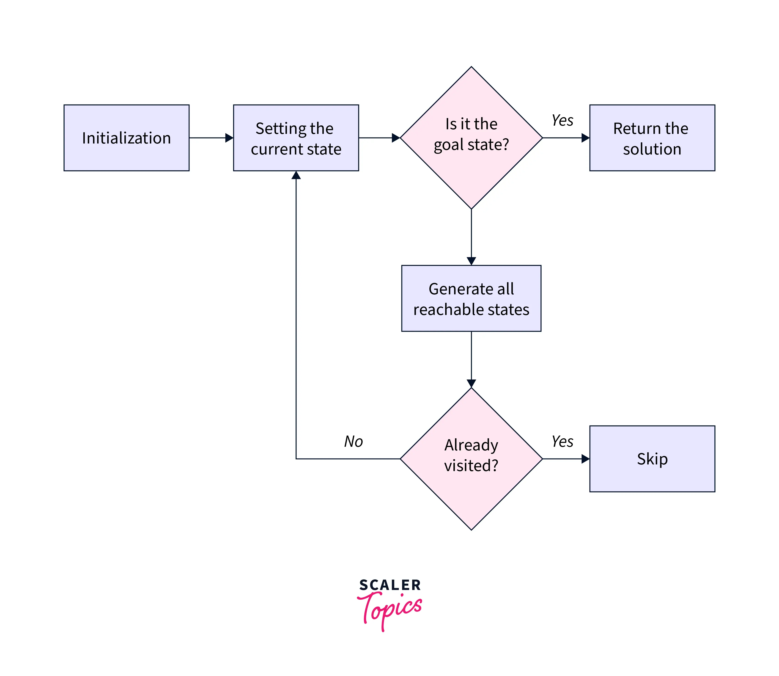
Steps in State Space Search
The steps involved in state space search are as follows:

Slide 6
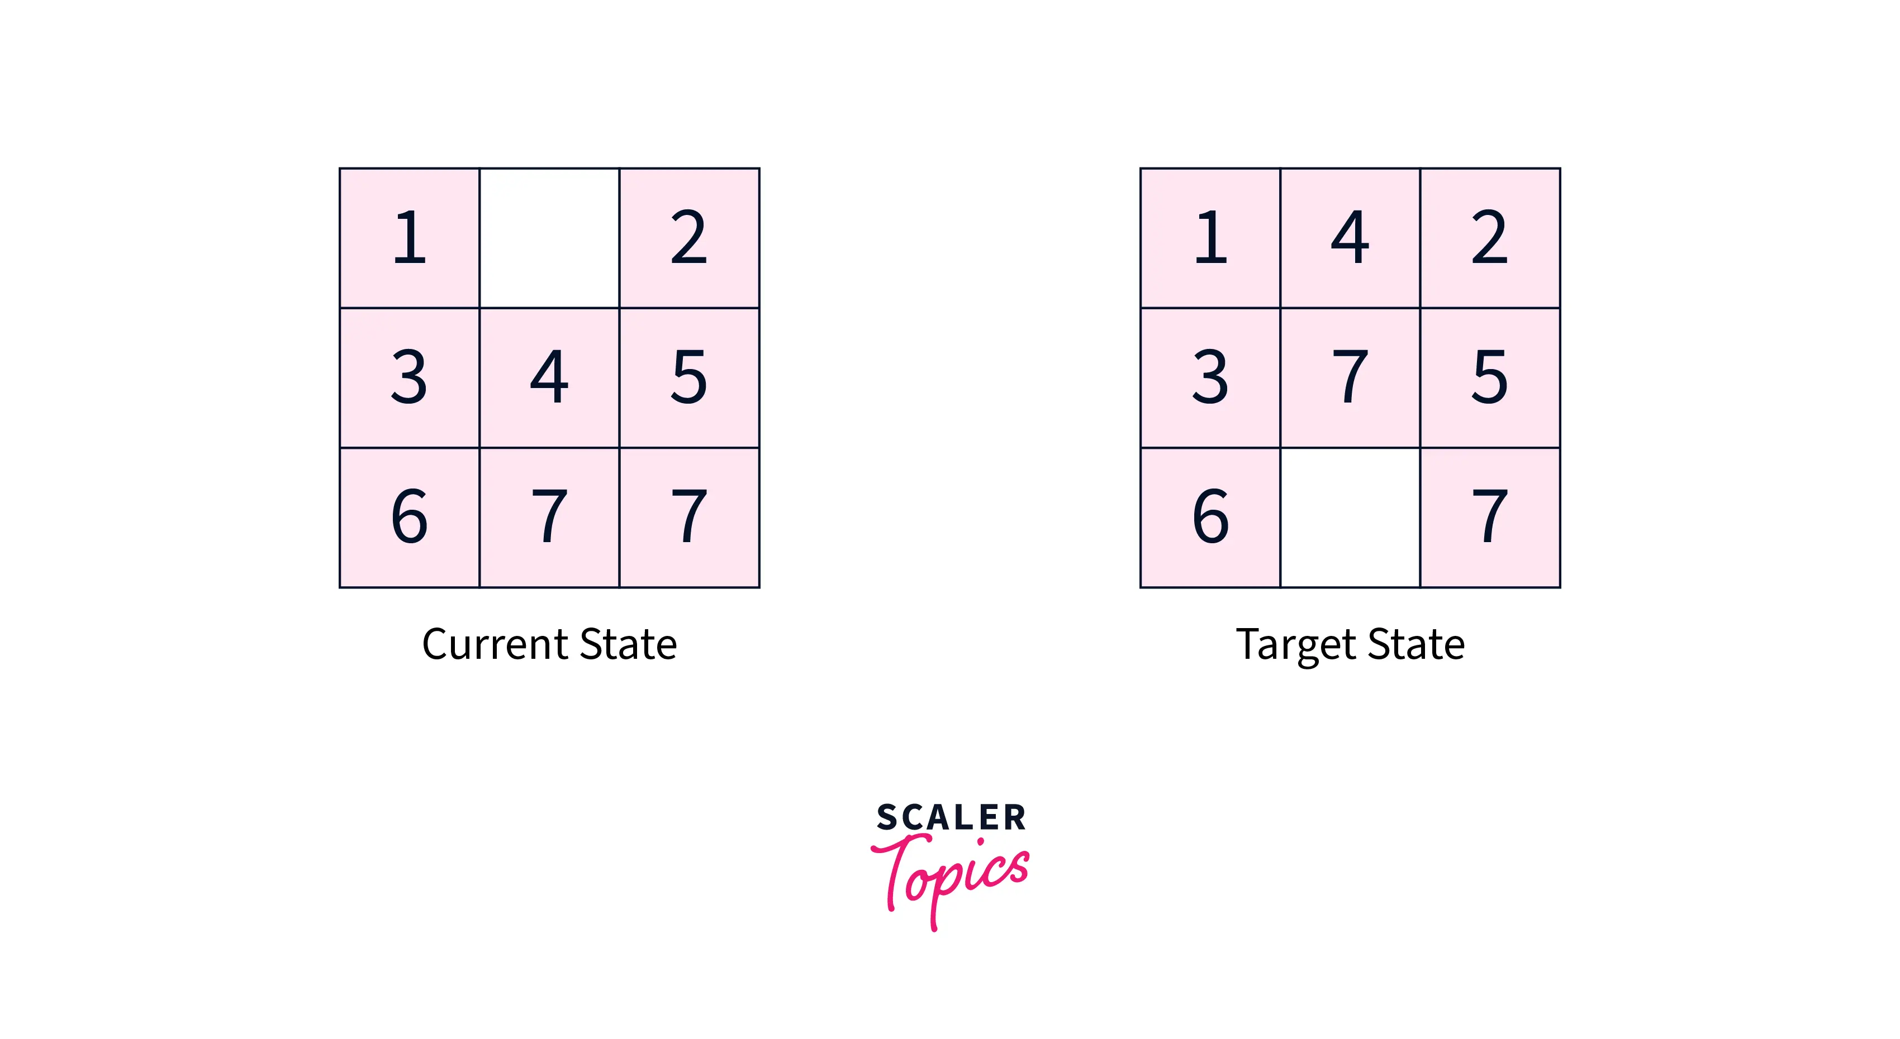
Example of State Space Search
The 8-puzzle problem is a commonly used example of a state space search. It is a sliding puzzle game consisting of 8 numbered tiles arranged in a 3x3 grid and one blank space. The game aims to rearrange the tiles from their initial state to a final goal state by sliding them into the blank space.
To represent the state space in this problem, we use the nine tiles in the puzzle and their respective positions in the grid. Each state in the state space is represented by a 3x3 array with values ranging from 1 to 8, and the blank space is represented as an empty tile.
The initial state of the puzzle represents the starting configuration of the tiles, while the goal state represents the desired configuration. Search algorithms utilize the state space to find a sequence of moves that will transform the initial state into the goal state.

Slide 7
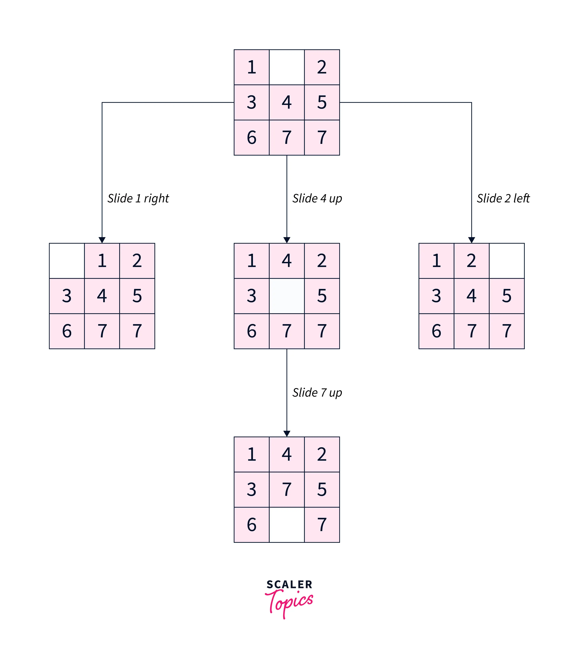

Slide 8
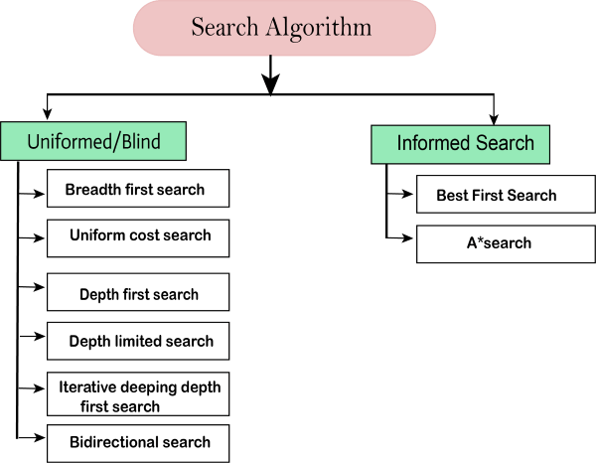
Search Algorithms in Artificial Intelligence
Search algorithms are one of the most important areas of Artificial Intelligence. This topic will explain all about the search algorithms in AI.
Types of search algorithms
Based on the search problems we can classify the search algorithms into uninformed (Blind search) search and informed search (Heuristic search) algorithms.

Slide 9
Uninformed Search Algorithms:
The search algorithms in this section have no additional information on the goal node other than the one provided in the problem definition. The plans to reach the goal state from the start state differ only by the order and/or length of actions. Uninformed search is also called Blind search. These algorithms can only generate the successors and differentiate between the goal state and non goal state. The following uninformed search algorithms are discussed in this section.
Depth First Search
Breadth First Search
Uniform Cost Search
Each of these algorithms will have:
A problem graph, containing the start node S and the goal node G.
A strategy, describing the manner in which the graph will be traversed to get to G.
A fringe, which is a data structure used to store all the possible states (nodes) that you can go from the current states.
A tree, that results while traversing to the goal node.
A solution plan, which the sequence of nodes from S to G.

Slide 10
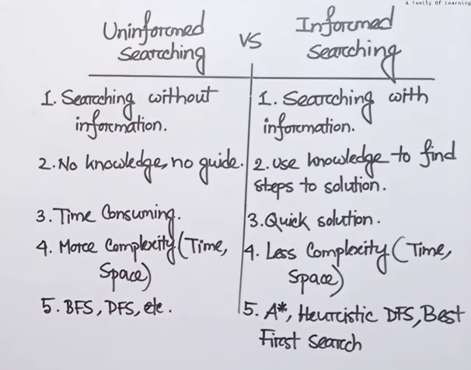
Informed Search Algorithms:
Here, the algorithms have information on the goal state, which helps in more efficient searching. This information is obtained by something called a heuristic. In this section, we will discuss the following search algorithms.
Greedy Search
A* Tree Search
A* Graph Search
Search Heuristics: In an informed search, a heuristic is a function that estimates how close a state is to the goal state. For example – Manhattan distance, Euclidean distance, etc. (Lesser the distance, closer the goal.) Different heuristics are used in different informed algorithms discussed below.

Slide 11
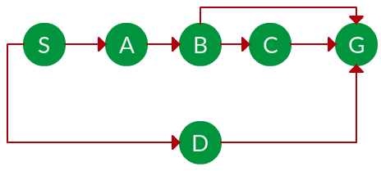
Breadth First Search:
Breadth-first search (BFS) is an algorithm for traversing or searching tree or graph data structures. It starts at the tree root (or some arbitrary node of a graph, sometimes referred to as a ‘search key’), and explores all of the neighbor nodes at the present depth prior to moving on to the nodes at the next depth level. It is implemented using a queue. Example: Question. Which solution would BFS find to move from node S to node G if run on the graph below?

Slide 12
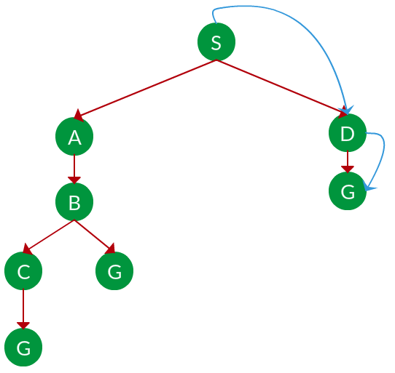
Solution. The equivalent search tree for the above graph is as follows. As BFS traverses the tree “shallowest node first”, it would always pick the shallower branch until it reaches the solution (or it runs out of nodes, and goes to the next branch). The traversal is shown in blue arrows.

Slide 13
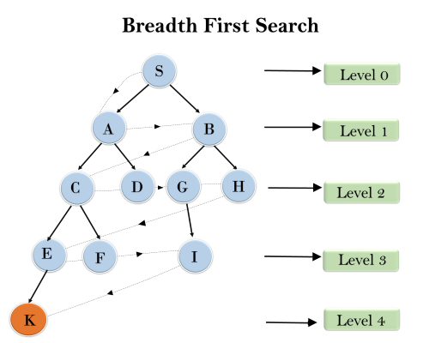
Example:
In the below tree structure, we have shown the traversing of the tree using BFS algorithm from the root node S to goal node K. BFS search algorithm traverse in layers, so it will follow the path which is shown by the dotted arrow, and the traversed path will be:
S---> A--->B---->C--->D---->G--->H--->E---->F---->I---->K
Time Complexity: Time Complexity of BFS algorithm can be obtained by the number of nodes traversed in BFS until the shallowest Node. Where the d= depth of shallowest solution and b is a node at every state.
T (b) = 1+b²+b³+.......+ b^{d}= O (b^{d})
Space Complexity: Space complexity of BFS algorithm is given by the Memory size of frontier which is O(b^{d}).
Completeness: BFS is complete, which means if the shallowest goal node is at some finite depth, then BFS will find a solution.
Optimality: BFS is optimal if path cost is a non-decreasing function of the depth of the node.

Slide 14
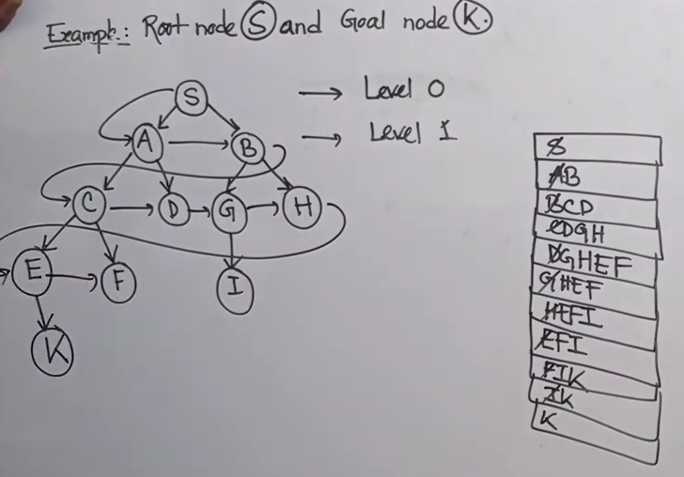

Slide 15
Depth First Search:
Depth-first search (DFS) is an algorithm for traversing or searching tree or graph data structures. The algorithm starts at the root node (selecting some arbitrary node as the root node in the case of a graph) and explores as far as possible along each branch before backtracking. It uses last in- first-out strategy and hence it is implemented using a stack.
Example:
Question. Which solution would DFS find to move from node S to node G if run on the graph below?

Slide 16
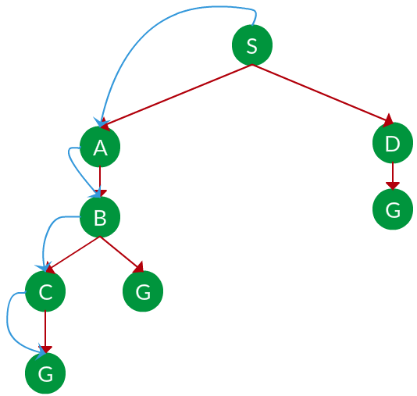
Solution. The equivalent search tree for the above graph is as follows. As DFS traverses the tree “deepest node first”, it would always pick the deeper branch until it reaches the solution (or it runs out of nodes, and goes to the next branch). The traversal is shown in blue arrows.
Path: S -> A -> B -> C -> G

Slide 17
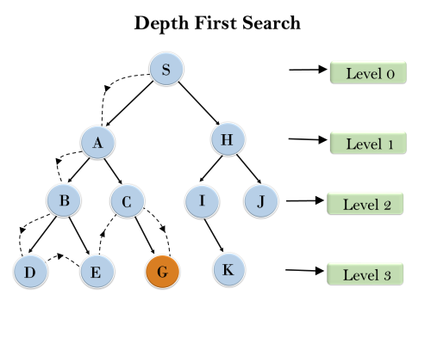
Example:
In the below search tree, we have shown the flow of depth-first search, and it will follow the order as:
Root node--->Left node ----> right node.
It will start searching from root node S, and traverse A, then B, then D and E, after traversing E, it will backtrack the tree as E has no other successor and still goal node is not found. After backtracking it will traverse node C and then G, and here it will terminate as it found goal node.
Completeness: DFS search algorithm is complete within finite state space as it will expand every node within a limited search tree.
Time Complexity: Time complexity of DFS will be equivalent to the node traversed by the algorithm. It is given by:
T(n)= 1+ n²+ n³ +.........+ n^{m}=O(n^{m})
Where, m= maximum depth of any node and this can be much larger than d (Shallowest solution depth)
Space Complexity: DFS algorithm needs to store only single path from the root node, hence space complexity of DFS is equivalent to the size of the fringe set, which is O(bm).

Slide 18
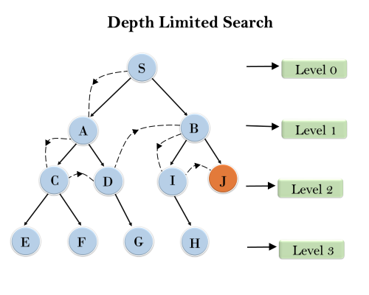
3. Depth-Limited Search Algorithm:
A depth-limited search algorithm is similar to depth-first search with a predetermined limit. Depth-limited search can solve the drawback of the infinite path in the Depth-first search. In this algorithm, the node at the depth limit will treat as it has no successor nodes further.
Depth-limited search can be terminated with two Conditions of failure:
Standard failure value: It indicates that problem does not have any solution.
Cutoff failure value: It defines no solution for the problem within a given depth limit.
Completeness: DLS search algorithm is complete if the solution is above the depth-limit.
Time Complexity: Time complexity of DLS algorithm is O(b^{ℓ}).
Space Complexity: Space complexity of DLS algorithm is O(b×ℓ).
Optimal: Depth-limited search can be viewed as a special case of DFS, and it is also not optimal even if ℓ>d.

Slide 19
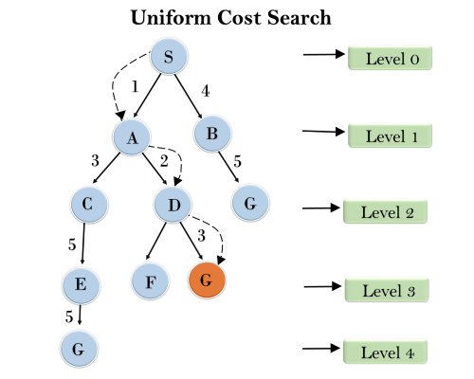
4. Uniform-cost Search Algorithm:
Uniform-cost search is a searching algorithm used for traversing a weighted tree or graph. This algorithm comes into play when a different cost is available for each edge. The primary goal of the uniform-cost search is to find a path to the goal node which has the lowest cumulative cost. Uniform-cost search expands nodes according to their path costs form the root node. It can be used to solve any graph/tree where the optimal cost is in demand. A uniform-cost search algorithm is implemented by the priority queue. It gives maximum priority to the lowest cumulative cost. Uniform cost search is equivalent to BFS algorithm if the path cost of all edges is the same.
Completeness:
Uniform-cost search is complete, such as if there is a solution, UCS will find it.
Time Complexity:
Let C* is Cost of the optimal solution, and ε is each step to get closer to the goal node. Then the number of steps is = C*/ε+1. Here we have taken +1, as we start from state 0 and end to C*/ε.
Hence, the worst-case time complexity of Uniform-cost search isO(b^{1 + [C*/ε]})/.
Space Complexity:
The same logic is for space complexity so, the worst-case space complexity of Uniform-cost search is O(b^{1 + [C*/ε]}).
Optimal:
Uniform-cost search is always optimal as it only selects a path with the lowest path cost.

Slide 20
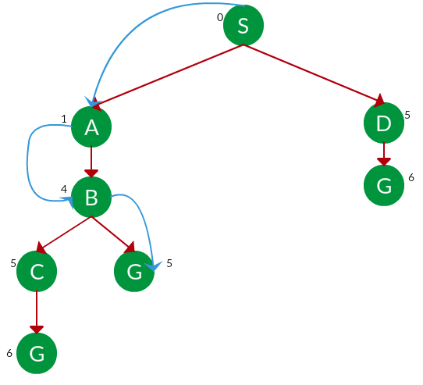
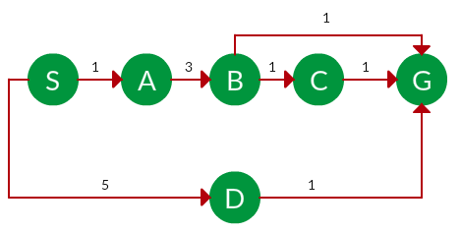
Example: Question. Which solution would UCS find to move from node S to node G if run on the graph below?
Solution. The equivalent search tree for the above graph is as follows. The cost of each node is the cumulative cost of reaching that node from the root. Based on the UCS strategy, the path with the least cumulative cost is chosen. Note that due to the many options in the fringe, the algorithm explores most of them so long as their cost is low, and discards them when a lower-cost path is found; these discarded traversals are not shown below. The actual traversal is shown in blue.
Path: S -> A -> B -> G Cost: 5

Slide 21
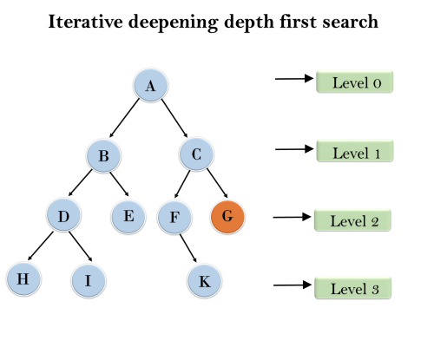
5. Iterative deepening depth-first Search:
The iterative deepening algorithm is a combination of DFS and BFS algorithms. This search algorithm finds out the best depth limit and does it by gradually increasing the limit until a goal is found.
This algorithm performs depth-first search up to a certain "depth limit", and it keeps increasing the depth limit after each iteration until the goal node is found.
This Search algorithm combines the benefits of Breadth-first search's fast search and depth-first search's memory efficiency.
The iterative search algorithm is useful uninformed search when search space is large, and depth of goal node is unknown.
Example:
Following tree structure is showing the iterative deepening depth-first search. IDDFS algorithm performs various iterations until it does not find the goal node. The iteration performed by the algorithm is given as:
1'st Iteration-----> A 2'nd Iteration----> A, B, C 3'rd Iteration------>A, B, D, E, C, F, G 4'th Iteration------>A, B, D, H, I, E, C, F, K, G In the fourth iteration, the algorithm will find the goal node.

Slide 22
completeness:
This algorithm is complete is ifthe branching factor is finite.
Time Complexity:
Let's suppose b is the branching factor and depth is d then the worst-case time complexity is O(b^{d}).
Space Complexity:
The space complexity of IDDFS will be O(bd).
Optimal:
IDDFS algorithm is optimal if path cost is a non- decreasing function of the depth of the node.

Slide 23
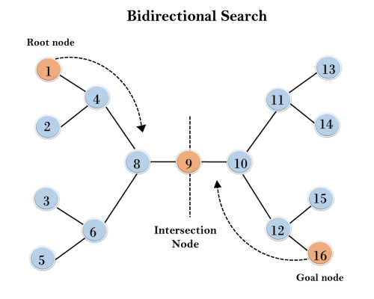
6. Bidirectional Search Algorithm:
Bidirectional search algorithm runs two simultaneous searches, one form initial state called as forward-search and other from goal node called as backward-search, to find the goal node. Bidirectional search replaces one single search graph with two small subgraphs in which one starts the search from an initial vertex and other starts from goal vertex. The search stops when these two graphs intersect each other.
Bidirectional search can use search techniques such as BFS, DFS, DLS, etc.
Example:
In the below search tree, bidirectional search algorithm is applied. This algorithm divides one graph/tree into two sub-graphs. It starts traversing from node 1 in the forward direction and starts from goal node 16 in the backward direction.
The algorithm terminates at node 9 where two searches meet.
Completeness: Bidirectional Search is complete if we use BFS in both searches.
Time Complexity: Time complexity of bidirectional search using BFS is O(b^{d}).
Space Complexity: Space complexity of bidirectional search is O(b^{d}).
Optimal: Bidirectional search is Optimal.

